Slide 1
Oauth Authentication with social networks

Slide 2
What is Oauth?
OAuth is an open standard to authorization. OAuth provides client applications a 'secure delegated access' to server resources on behalf of a resource owner.
It specifies a process for resource owners to authorize third-party access to their server resources without sharing their credentials.

Slide 3
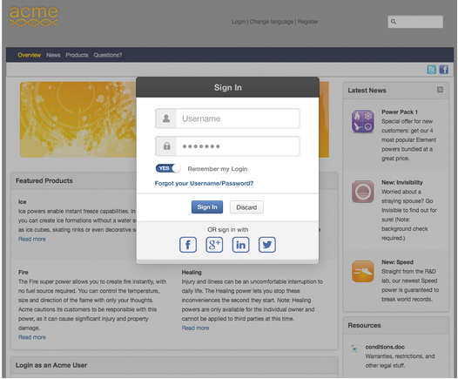
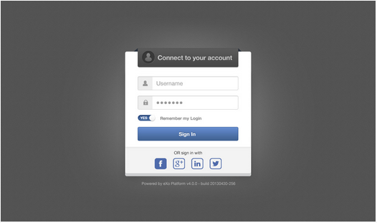
Login dialog

Slide 4
Login page
The list of buttons should be dynamically bound to the list of active provider
Users with an established link to a social network AND a password in eXo, should be able to log in either via with in With... button, or via the eXo Platform's username/password form.
Remember Me feature should work seamlessly when authentication has been done via a social network button.

Slide 5
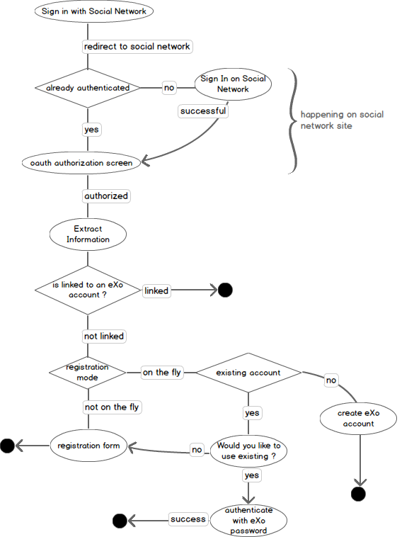
Sign In Flow

Slide 6
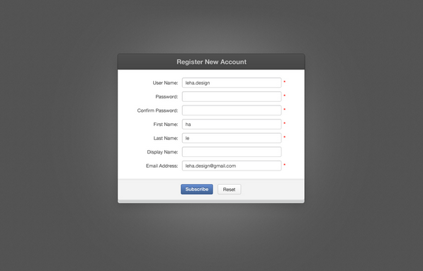
Register Form

Slide 7
Register
After login with the social network, user click on register button
The register form will be displayed and it is pre-filled with information extracted from the social network : user name, first name, last name, email.

Slide 8
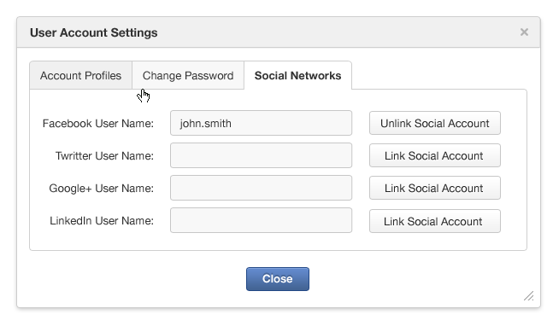
User Account Settings

Slide 9
User Account Settings
A new "Social Networks" tab is added In User account settings dialog (accessible from User > Settings)
$NETWORK User Name label, where $NETWORK is the name of the social network provider such as : Facebook, /Google +, LinkedIn
a text field for the user name in the social network when Exo account is linked with and it is readonly
a Link button with Link social account label or an Unlink button with Unlink social account label.

Slide 10
A Social network username can only be associated with a single eXo user account at a time.
When clicks on the Unlink button, the link between the social network and the eXo Platform account is reset and the text field is reset to blank. Hence, this user name can be used to link another eXo account or is available to register on the fly

Slide 11
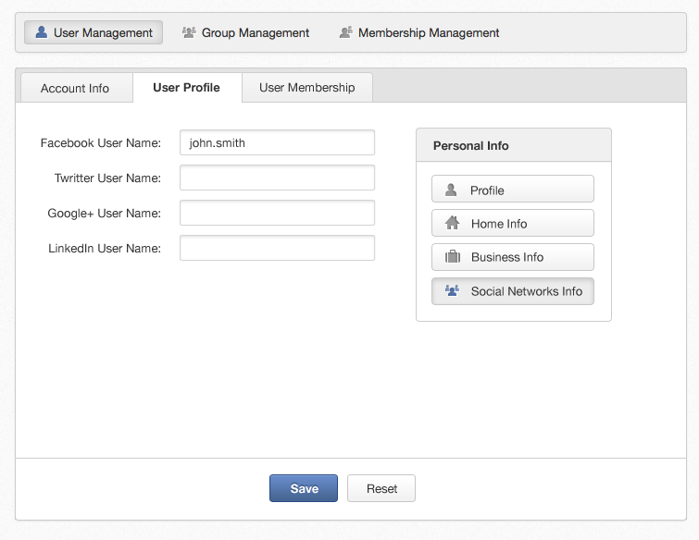
User Administration

Slide 12
User Administration
In User Profile tab of community management (accessible from Administration > Groups and Roles > User Management > Edit User Info), a Social Networks tab is added in Personal Info

